Slide 1
domain adaption summary
杨光磊
2020.12.07

Slide 2
内容概要
域适应介绍
当前工作介绍
下一步工作展望

Slide 3
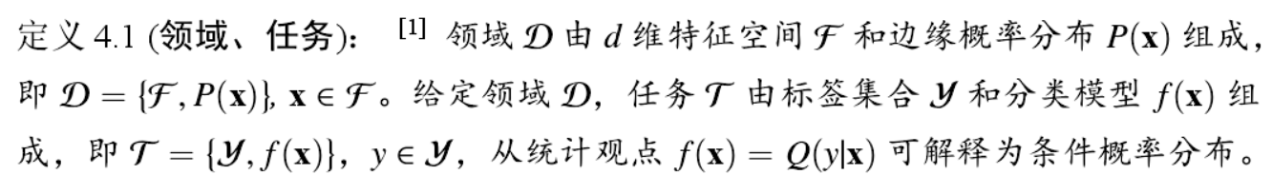
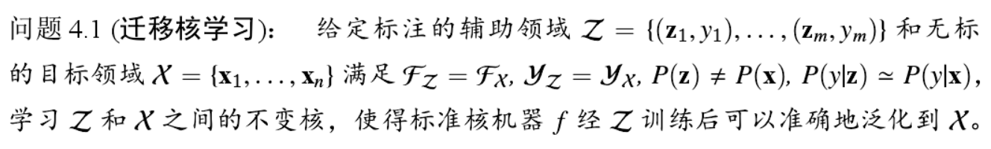
1.域适应
1.1域适应定义
From 迁移学习问题与方法研究 2014 龙明盛 博士论文

Slide 4
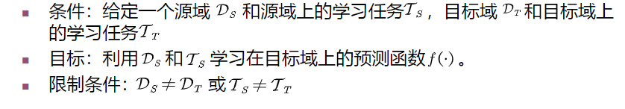
1.域适应
1.2域适应任务
From GitHub https://github.com/jindongwang/transferlearning

Slide 5
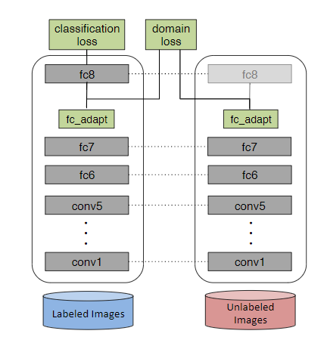
1.域适应
DDC：Deep Domain Confusion: Maximizing for Domain Invariance (Eric Tzeng) arXiv-14
第一次将 MMD 引入 CNN
2.1基本算法
特征匹配 MMD

Slide 6
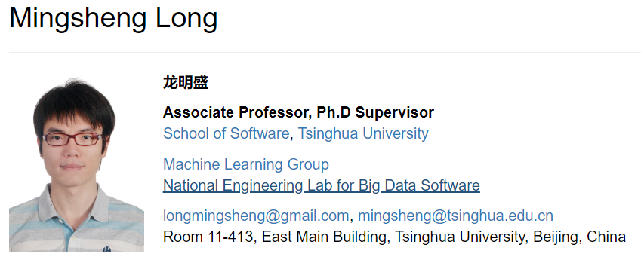
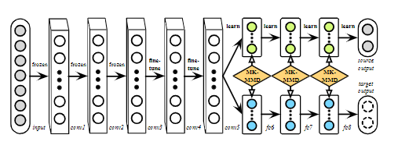
1.域适应
DAN：Learning Transferable Features with Deep Adaptation Networks ICML-15
把MKK-MMD加入到神经网络中
2.1基本算法

Slide 7
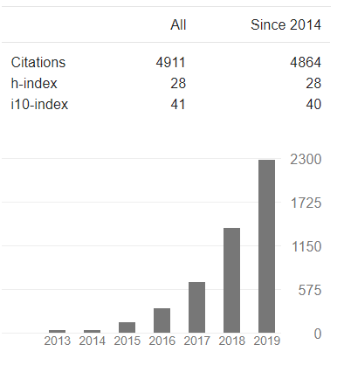
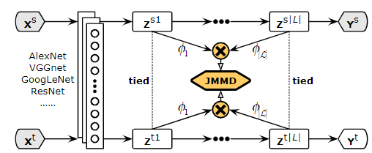
1.域适应
JAN:Deep transfer learning with joint adaptation networks ICML-17
First joint maximum mean discrepancy
2.1基本算法

Slide 8
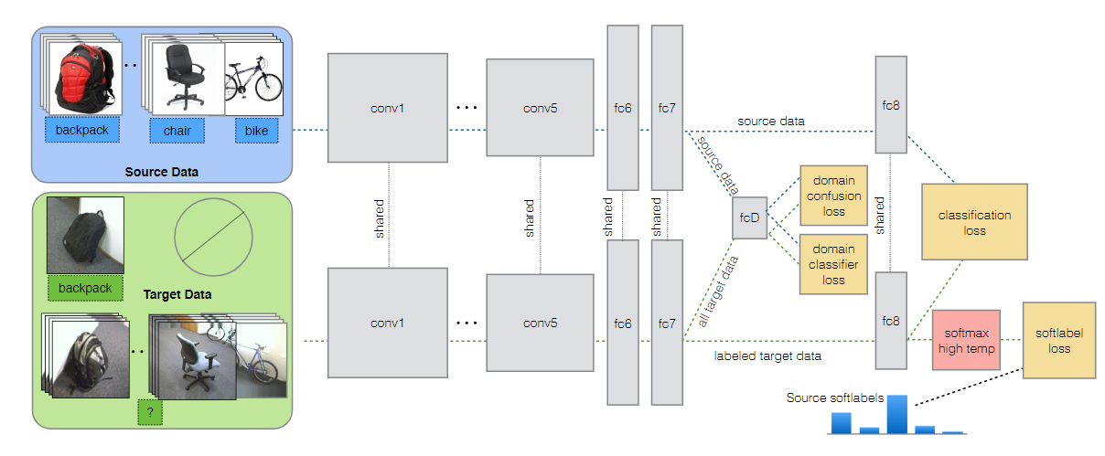
1.域适应
Adversarial Discriminative Domain Adaptation(Eric Tzeng)ICCV-2015
2.1基本算法
对抗生成 GAN

Slide 9
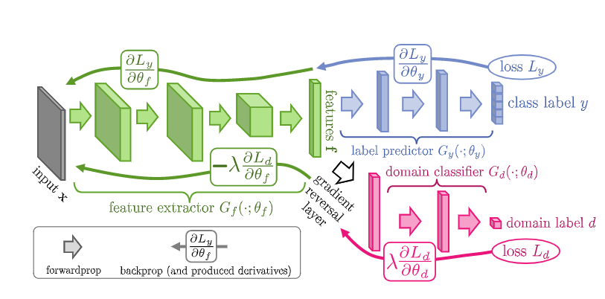
1.域适应
DANN: Domain-Adversarial Training of Neural Networks (Yaroslav Ganin) JMLR-2017
2.1基本算法
对抗生成 GAN

Slide 10
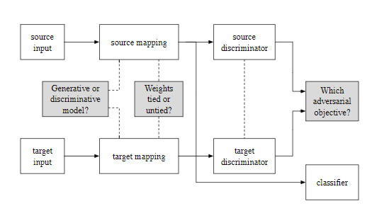
1.域适应
ADDA: Adversarial Discriminative Domain Adaptation (Eric Tzeng) CVPR-2017
2.1基本算法
对抗生成 GAN

Slide 11
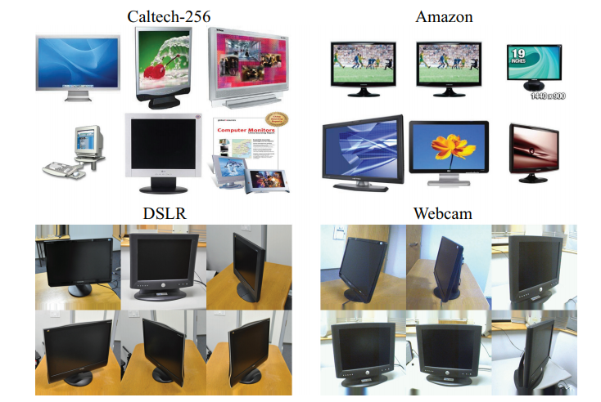
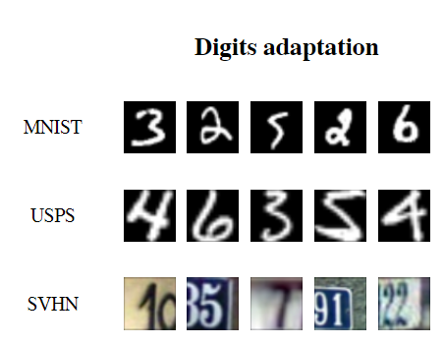
1.域适应
Office-31
2.2典型数据集

Slide 12
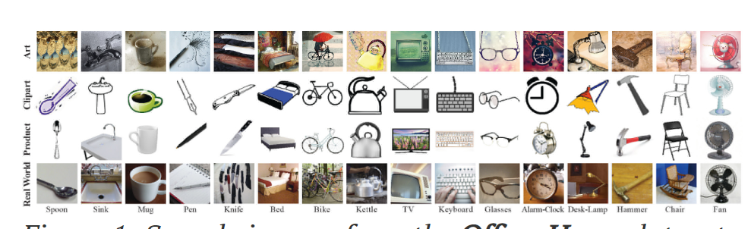
1.域适应
2.2典型数据集
Office-home

Slide 13
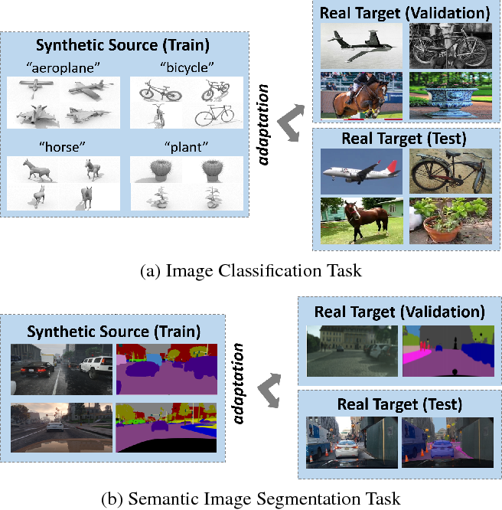
1.域适应
2.2典型数据集
VisDA-2017

Slide 14
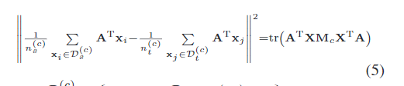
1.域适应
JDA:Transfer Feature Learning with Joint Distribution Adaptation(shengming Long) ICCV 2013
2.3 最新动向
Conditional distribution adaption– class MMD- CCA
Pseudo label-Class MMD
2. although many of the pseudo target labels are incorrect due to the differences in
both the marginal and conditional distributions,
we can still leverage them to match the conditional distributions with
the revised MMD measure defined in Equation (5).

Slide 15
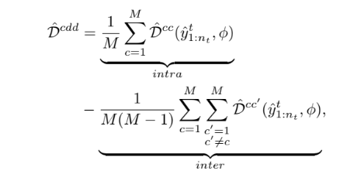
1.域适应
CAN:Contrastive Adaptation Network for Unsupervised Domain Adaptation(Guoliang Kang) CVPR 2019
2.3 最新动向
Pseudo label-Class MMD
intra- and inter-class domain discrepancies

Slide 16
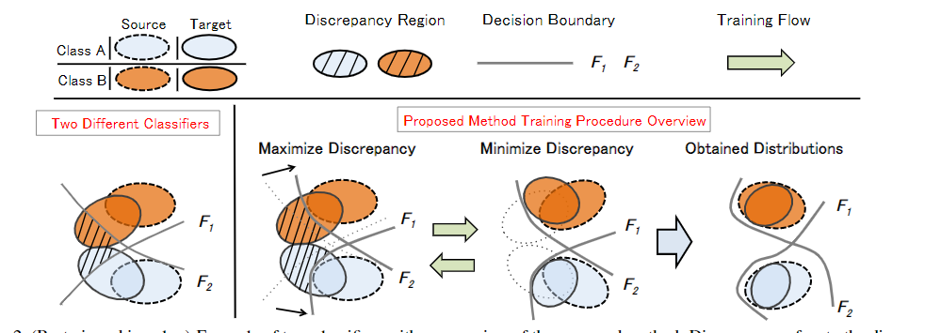
1.域适应
MCD:Maximum Classifier Discrepancy for Unsupervised Domain Adaptation CVPR 2018
2.3 最新动向
Discrepency loss + Adversarial classifier

Slide 17
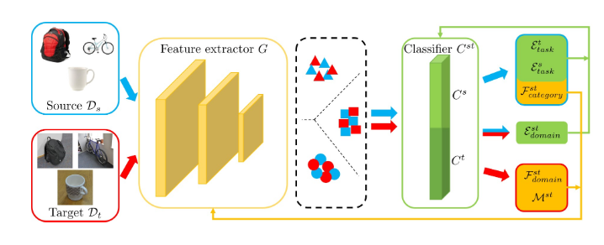
1.域适应
Symnet : Domain-symmetric networks for adversarial domain adaptation CVPR 2019
2.3 最新动向
Adversarial classifier

Slide 18
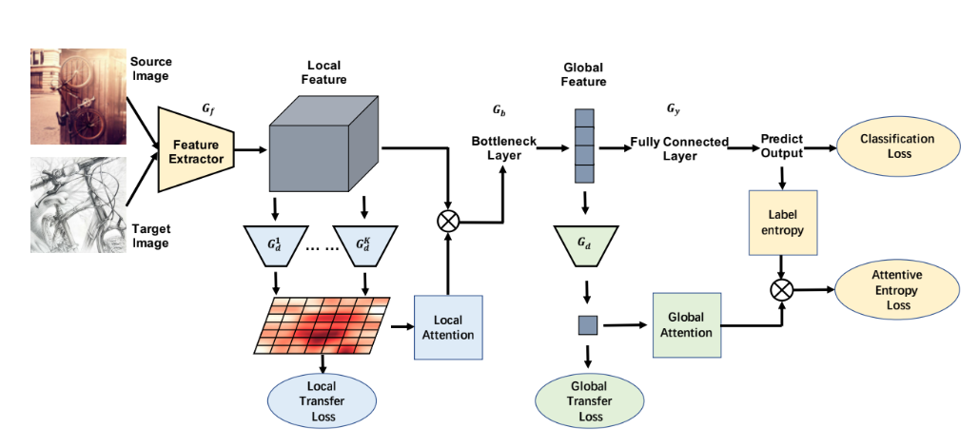
1.域适应
TADA: Transferable Attention for Domain Adaptation(Mingsheng Long 通信) CVPR 2019

Slide 19
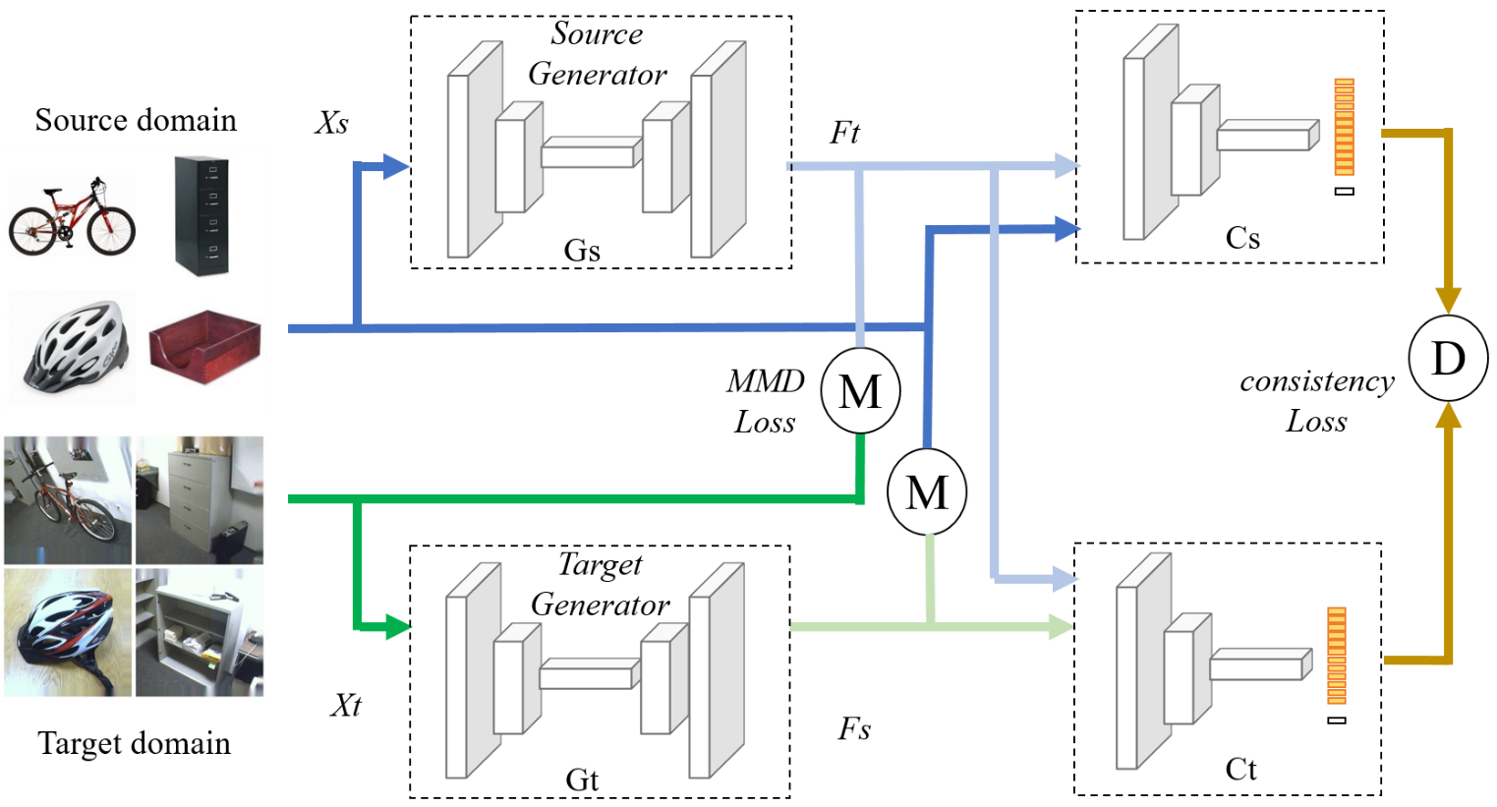
2.当前工作介绍
Notes:
将 MMD 于 GAN融合
通过 domain label 修正 pseudo label

Slide 20
3.下一步工作展望
1.将会议拓展为期刊
增加在VisDA2017 上的测试
增加高置信度的pseudo label
引入 confusion matirx

Slide 21
3.下一步工作展望
2.从分类向分割转移
DA Segmentation 研究啥？
答：
normal-to-foggy (Cityscapes to Cityscapes-foggy),
synthetic-to-real (Sim10k to Cityscapes),
and cross-camera (Kitti to Cityscapes)
DA Segmentation 啥方法？
Feature level align
Image transfer
主要数据集有哪些？
Synthetic： GAT5 SYNTHIA
Real：cityscapes KITTI

Slide 22
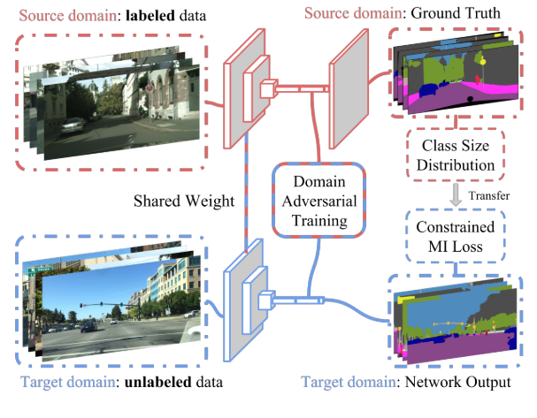
3.下一步工作展望
FCNs in the Wild: Pixel-level Adversarial and Constraint-based Adaptation(Judy Hoffman) arXiv 2016
第一次提出了 segmentation in domain adaption, task
2.从分类向分割转移
GAN

Slide 23
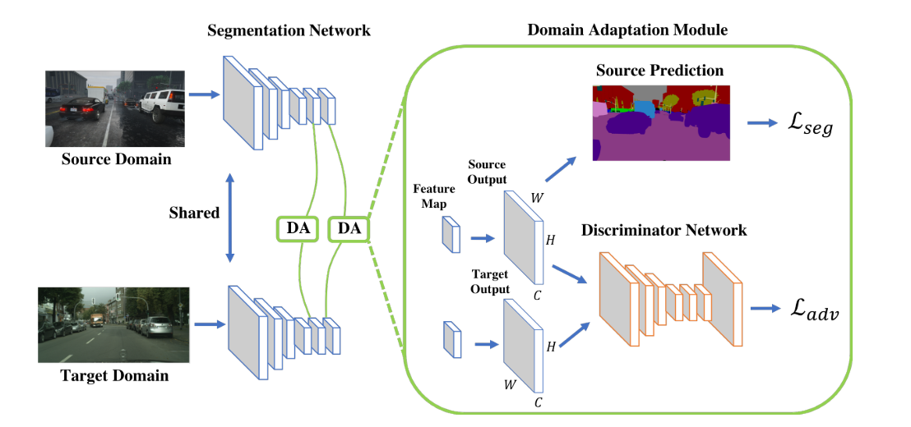
3.下一步工作展望
2.从分类向分割转移
GAN
Learning to Adapt Structured Output Space for Semantic Segmentation
CVPR 2018

Slide 24
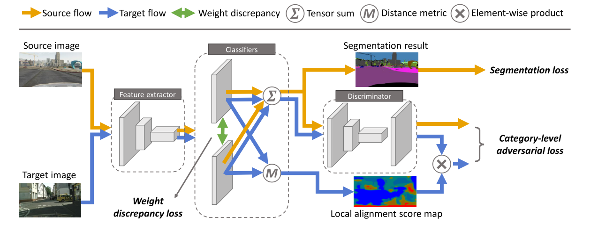
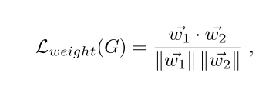
3.下一步工作展望
2.从分类向分割转移
Taking A Closer Look at Domain Shift: Category-level Adversaries for Semantics Consistent Domain Adaptation CVPR 2019
GAN

Slide 25
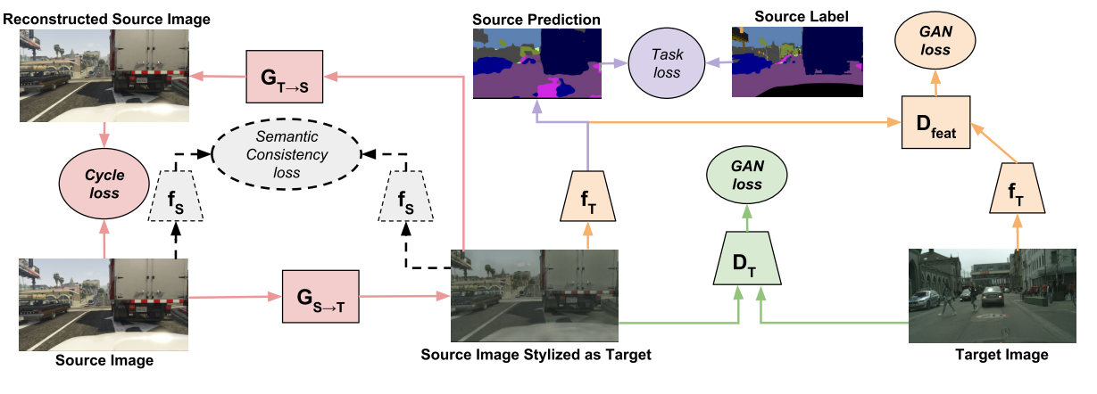
3.下一步工作展望
2.从分类向分割转移
CyCADA: Cycle-Consistent Adversarial Domain Adaptation(Judy Hoffman) ICML2018
将 cycle gan 引入 segmentation da
Image transfer

Slide 26
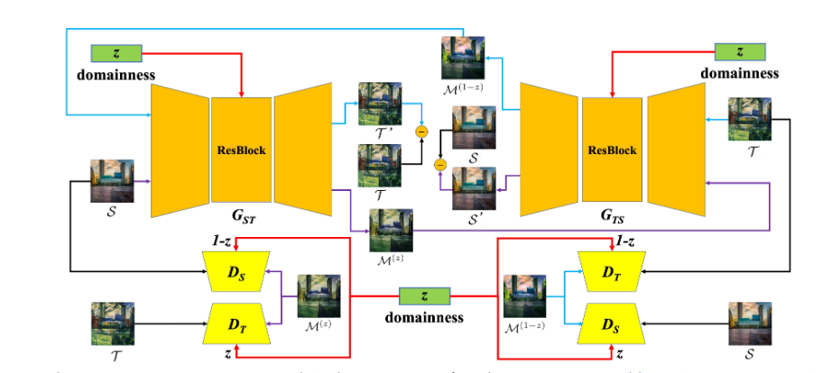
3.下一步工作展望
2.从分类向分割转移
DLOW: Domain Flow for Adaptation and Generalization CVPR-2019
Image transfer

Slide 27
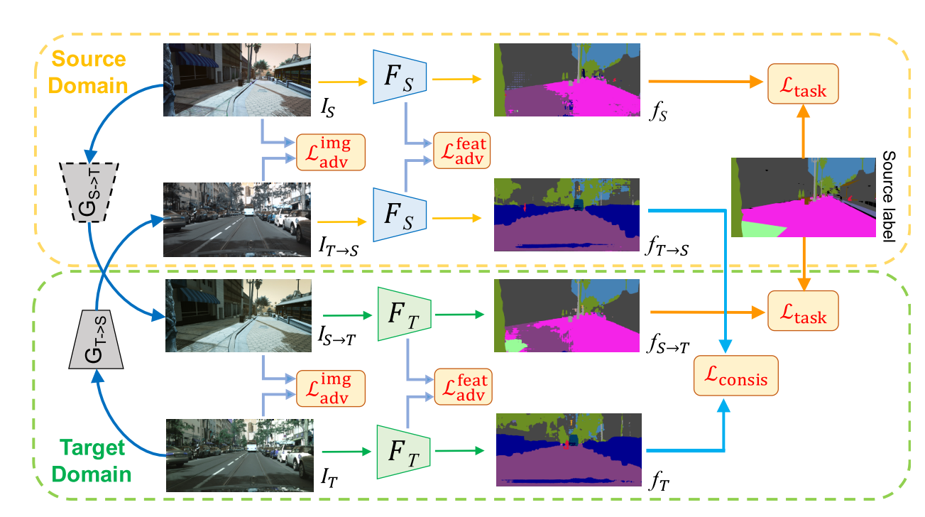
3.下一步工作展望
2.从分类向分割转移
CrDoCo: Pixel-level Domain Transfer with Cross-Domain Consistency CVPR-2019
Image transfer

Slide 28
3.下一步工作展望
2.从分类向分割转移
结论：
大多数方法还是基于GAN的进行域适应，feature align 无使用
大多集中在synthetic-to-real， 对于 normal-to- hard 讨论较少

Slide 29
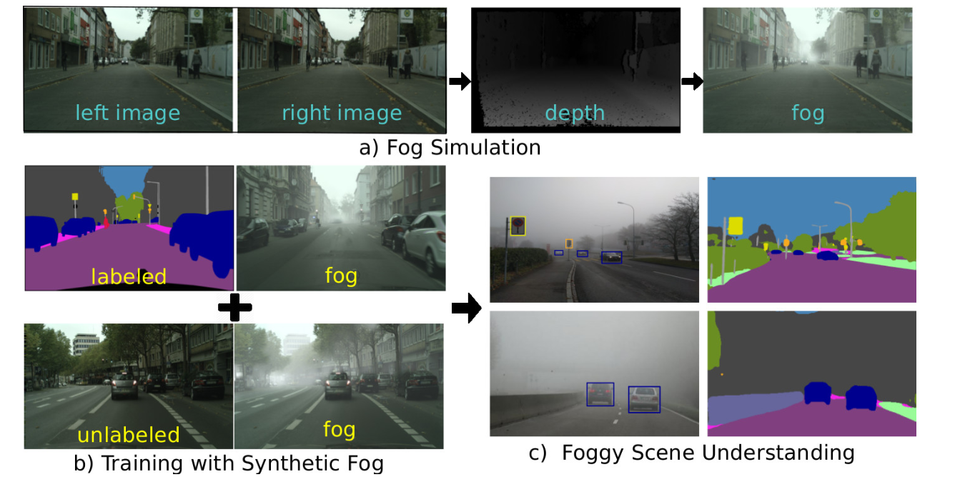
3.下一步工作展望
2.从分类向分割转移
Frog cityscapes datasets ETH

Slide 30
3.下一步工作展望
2.从分类向分割转移
Paper： Dengxin Dai
Semantic Foggy Scene Understanding with Synthetic Data IJCV2018
Model Adaptation with Synthetic and Real Data for Semantic Dense Foggy Scene Understanding ECCV2018
Curriculum Model Adaptation with Synthetic and Real Data for Semantic Foggy Scene Understanding IJCV 2019
Semantic Understanding of Foggy Scenes with Purely Synthetic Data ITSC(信息与通信工程
顶会)2019
Domain Adaptive Faster R-CNN for Object Detection in the Wild CVPR2018
Adapting Object Detectors via Selective Cross-Domain Alignment CVPR2019
Multi-Level Domain Adaptive Learning for Cross-Domain Detection ICCV2019
Multi-adversarial Faster-RCNN for Unrestricted Object Detection ICCV2019
few-shot Adaptive Faster R-CNN CVPR2019
Progressive Domain Adaptation for Object Detection CVPR2019
Strong-Weak Distribution Alignment for Adaptive Object Detection CVPR 2019
Exploring Object Relation in Mean Teacher for Cross-Domain Detection CVPR2019

Slide 31
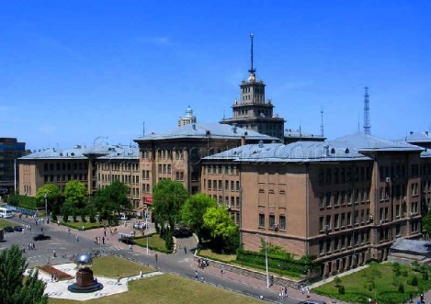
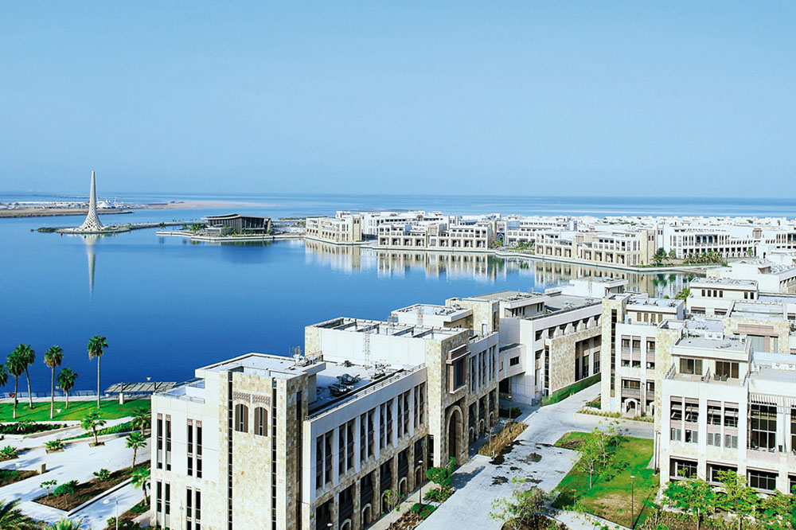
THANK YOU !

